Slide 1
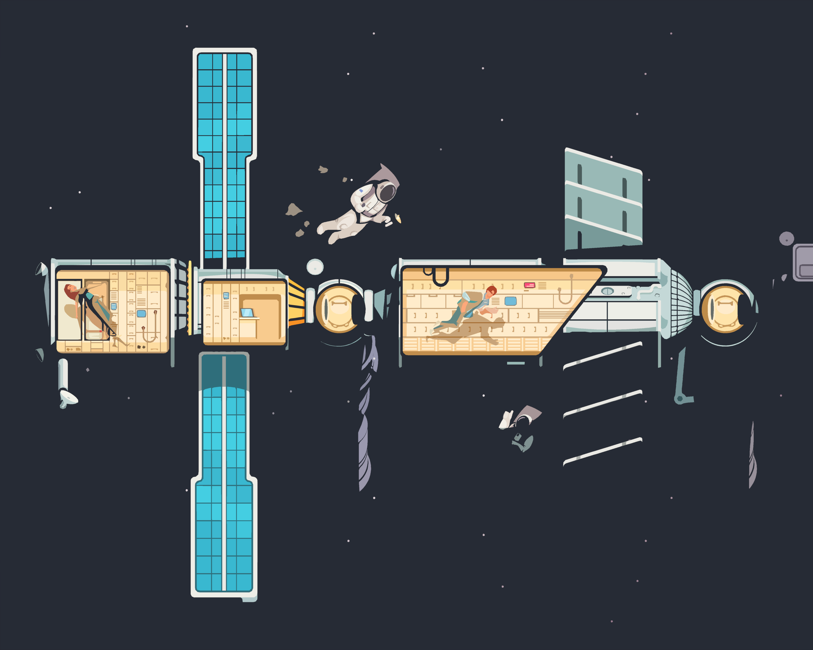

ISS DES design proposal SSD March 2022

Slide 2

Assumptions
Research data exchange between nations (public)
Private data exchange between space agencies (confidential)
Commercially viable ISS data for private organisations (business)
Stricter Confidentiality – Integrity – Availability requirements as part of the engagements listed above (e.g., data security, privacy assurance and costly experiments)
Rate limiting to address potential jitter and latency
Data sharing between pre-determined groups instead of individuals
Removing individual access to the data upon removal from groups or account termination
Minimising potential workload and operational IAM tasks

Slide 3
Limitations
An unprecedented increase in data volume
Limited scaling capability due to CPU, memory and IO limitations (monolithic)
File size limitations for a single file
Degraded performance on processing large files
Potential unauthorised information disclosures due to inappropriate docker container hardening even having a proper hardening at DB-level.

Slide 4
Components/Libraries
Python
Hashlib
Getpass
Mysql.connector
Cryptography & fernet
Flask
Flask-login
Flask-sqlalchemy
werkzeug
pytest
Python Locust
NGINX
MySQL
Ubuntu
Docker
Syslog-NG

Slide 5
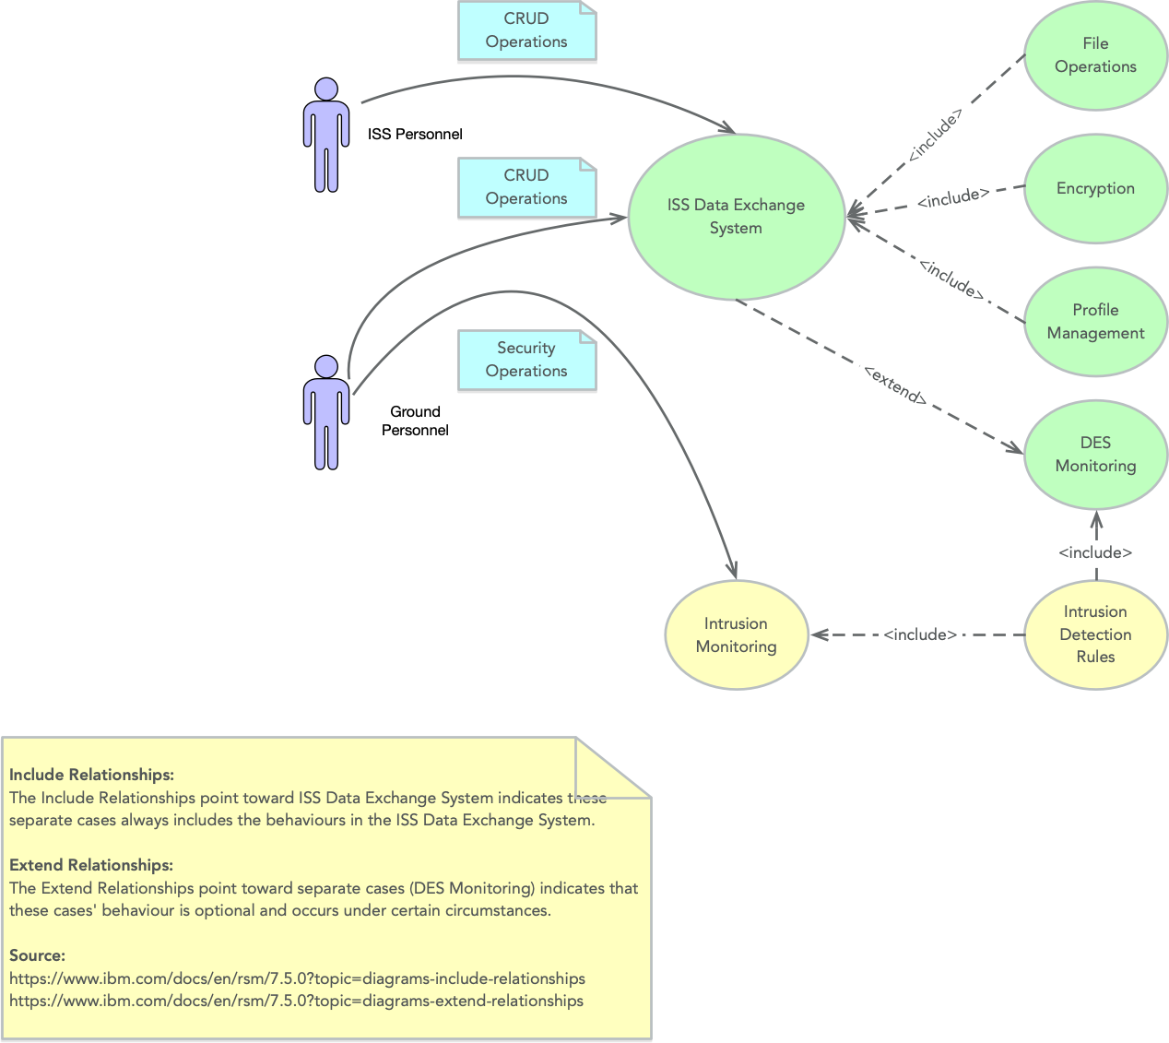
Use Case Diagram

Slide 6
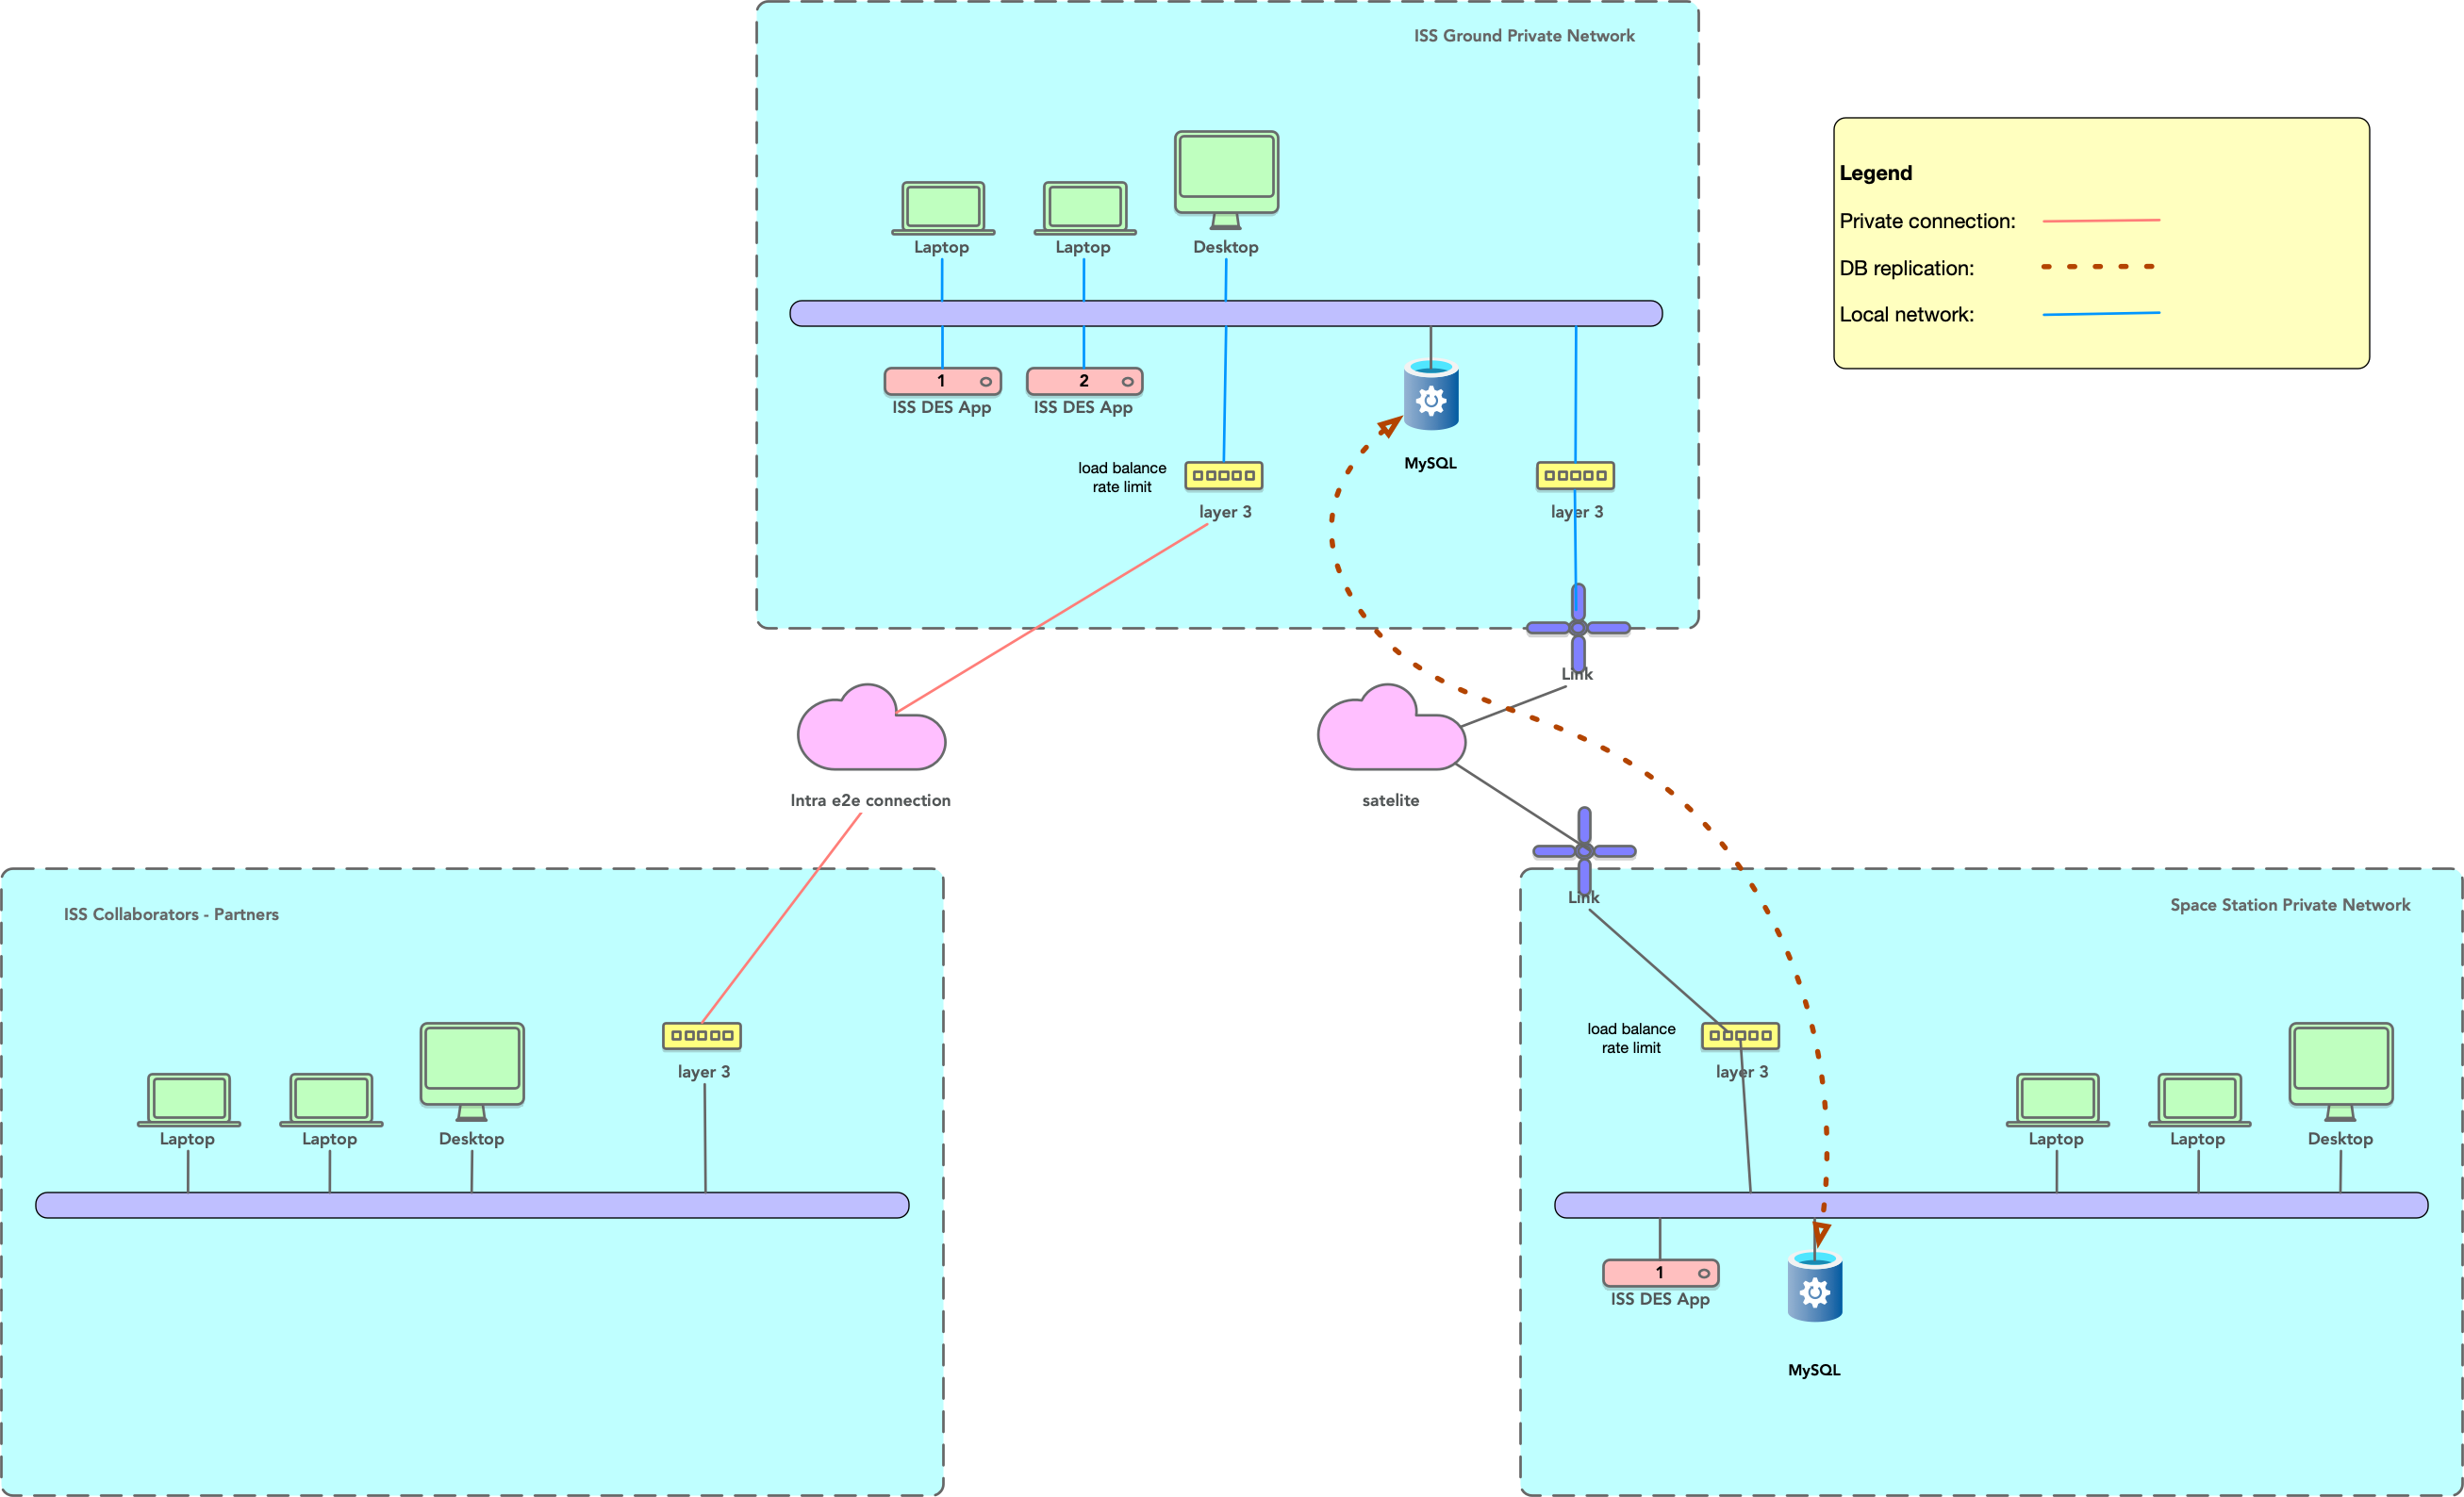
Technical Setup

Slide 7
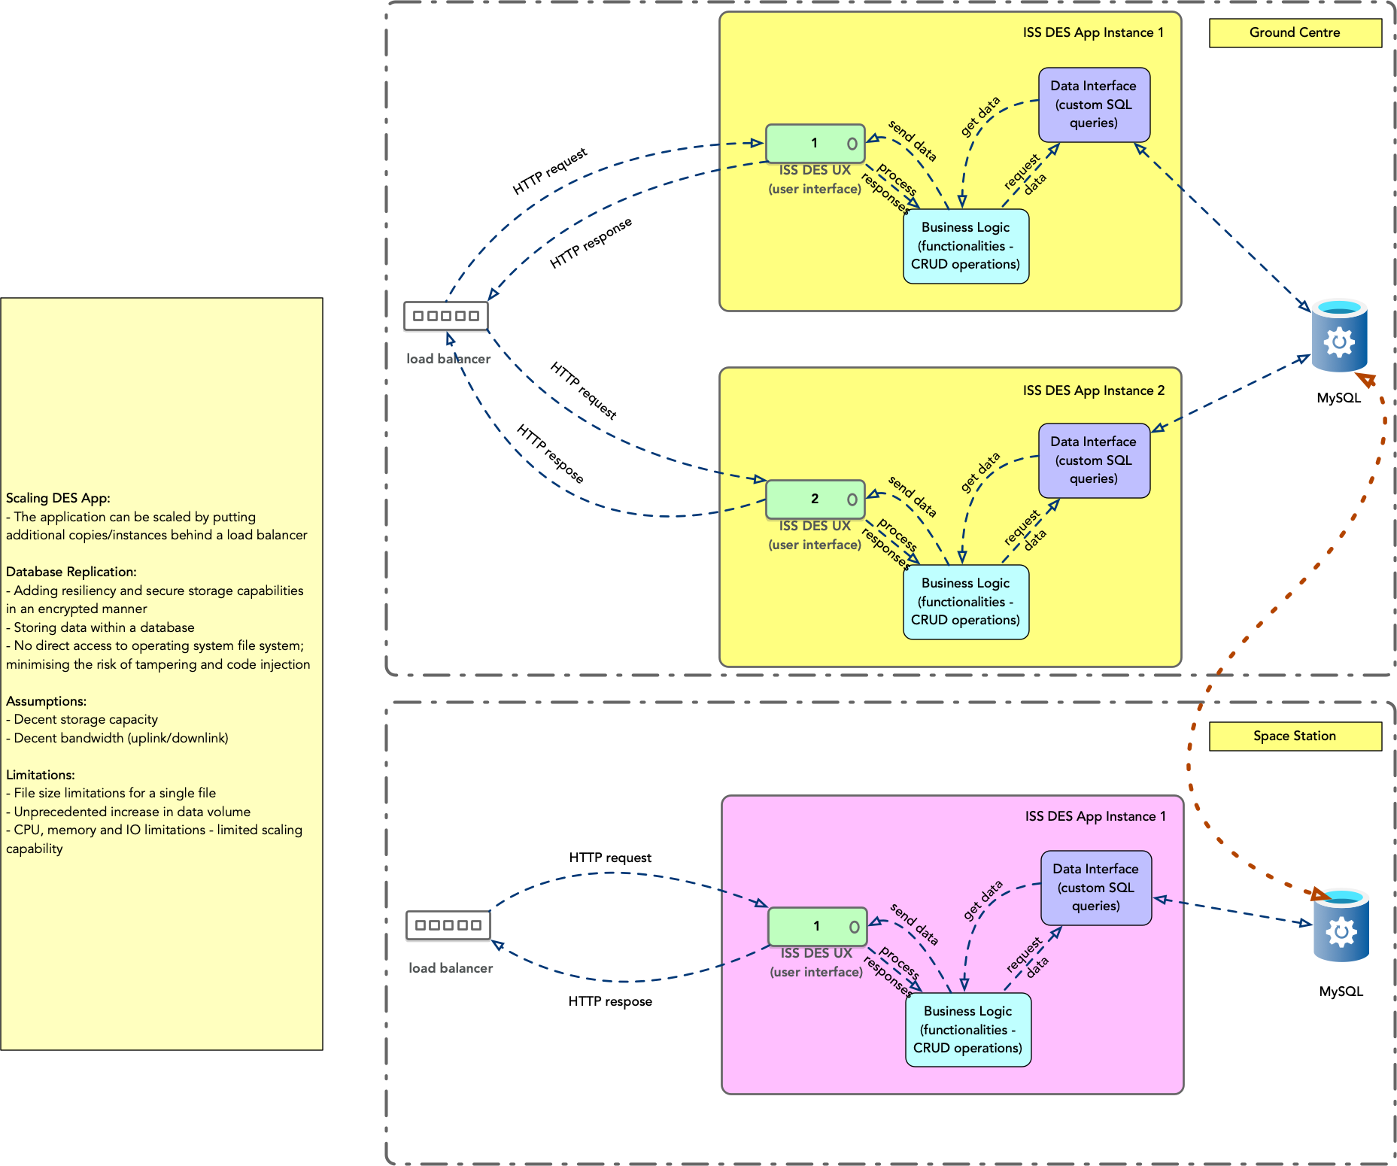
Monolithic View

Slide 8
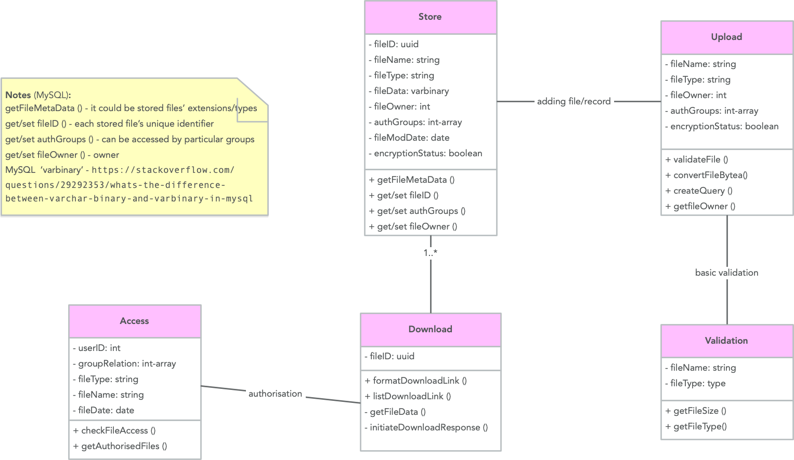
Class Diagrams

Slide 9
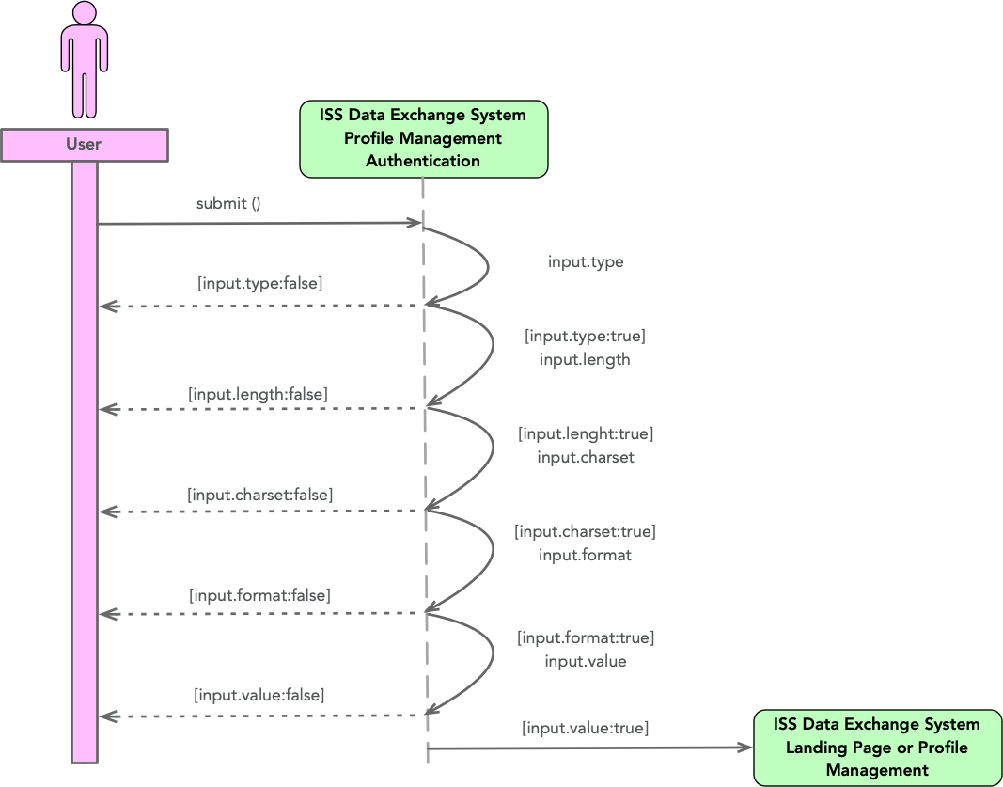
Sequence Diagrams

Slide 10
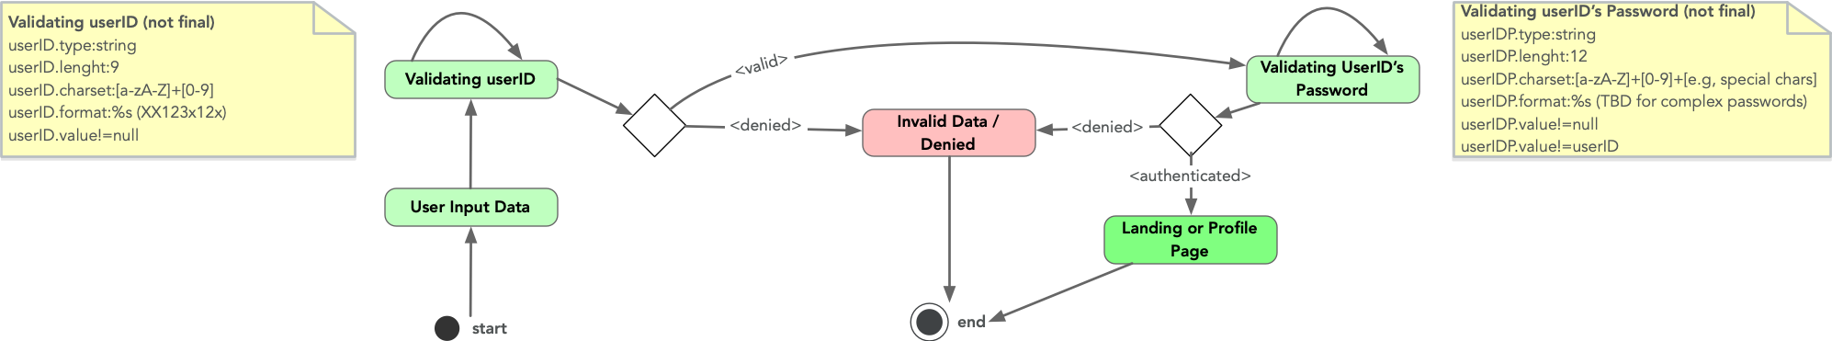
Activity Diagrams

